Slide 1


ONLINE BOOK STORE
GUIDED BY :
Dr.Sashikala Mishra
Dr.Sandeep Patil
GROUP MEMBERS NAMES:
1. Pratik Bathe (SC37)
2. Rutuja Jangle (SC48)
3. Shreyas Chavhan (SC55)
4. Sonal Shitole (SC56)
5. Sourabh Deshmane (SC57)

Slide 2

FINAL PRESENTATION OUTLINE Date- 14/06/21
PROBLEM STATEMENT
MOTIVATION
OBJECTIVES
METHODOLOGY/MODEL
HARDWARE AND SOFTWARE REQUIREMENTS
IMPLEMENTATION
RESULTS
CHALLENGES FACED
CONCLUSION AND FUTURE SCOPE

Slide 3

1. PROBLEM STATEMENT:
The Online Book store is an online web application where the customer can rent/purchase/lend books and sell books online.
The user gets three options to get the book- rent, purchase and rent for an year for free and one option for uploading books for rent/sale.
Through a web browser the customers can search for a book by its title, author or subject, later can add to the shopping cart and finally rent or purchase using the various transaction modes provided.
The user can login using his account details or new customers can register by creating an account.
DEPARTMENT OF COMPUTER ENGINEERING

Slide 4

2. MOTIVATION:
In today’s busy and digital world, readers and students who are connected a lot with books face a problem with its feasibility and accessibility.
If a reader wants to read a book, he/she has to purchase it at a high price or even if they go to a library to lend a book, they have to first take up the membership and have to return the book after a specific time period.
Hence a lot of money and time gets wasted in all this procedures.
Using this Website the user can rent or purchase a book online at a comparatively low rate instead of going out to a bookstore and wasting time, also the users who wish to rent or sell their used books can make some money by uploading their books on the website instead of throwing them away.
DEPARTMENT OF COMPUTER ENGINEERING

Slide 5
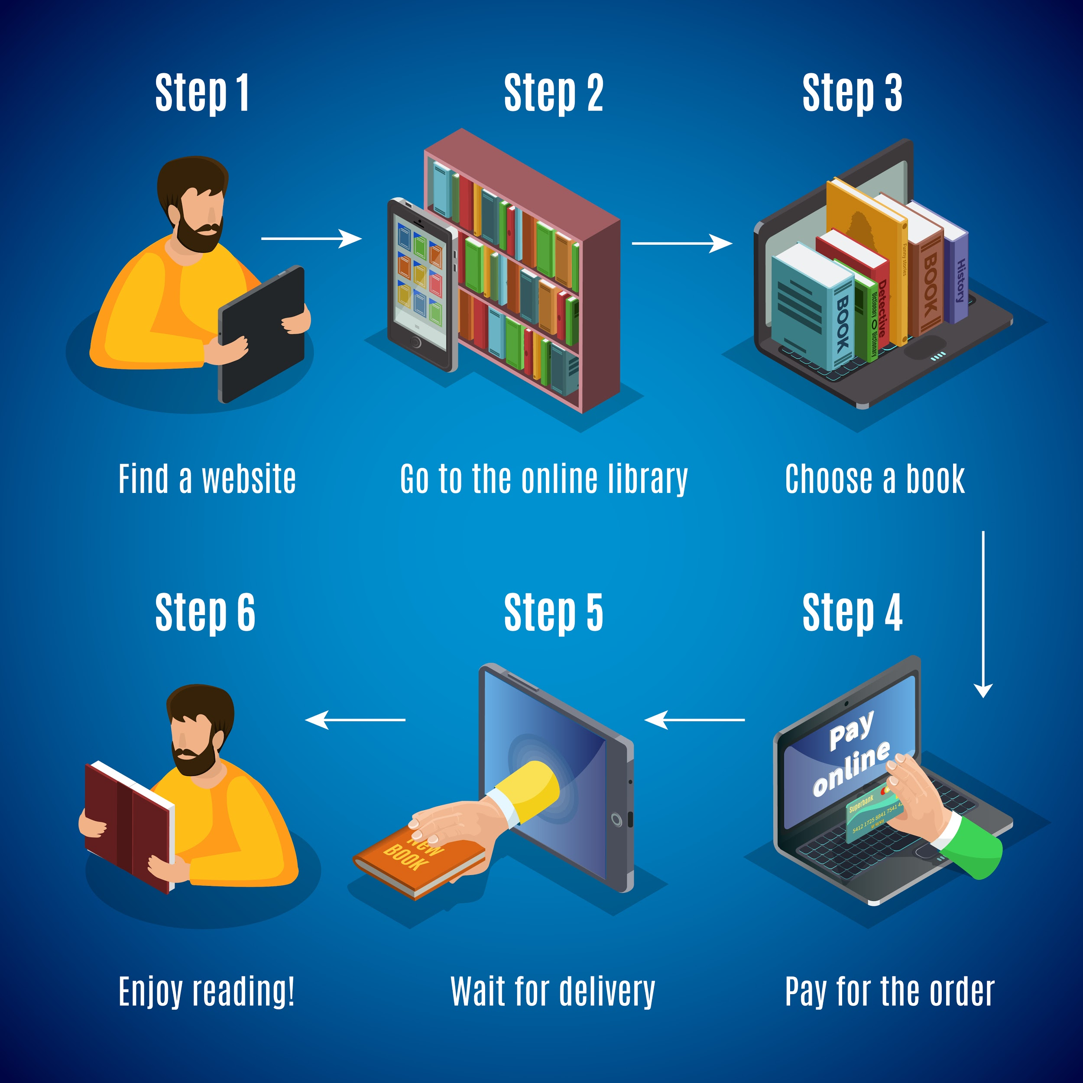
3. OBJECTIVE:
To provide an online book store that allows users to search, rent, purchase and lend a book at a very low cost and also upload their books for rent or for sale too.
To allow the user to order their books online through various modes of payment where the money will be directly transferred to the book owner securely.
To provide the Administrator with additional functionalities like power to delete or ban a user account and access all the user information and make interaction of book giver and receiver more feasible.
DEPARTMENT OF COMPUTER ENGINEERING
Notes:
Also this will save trees because of books recycling.

Slide 6
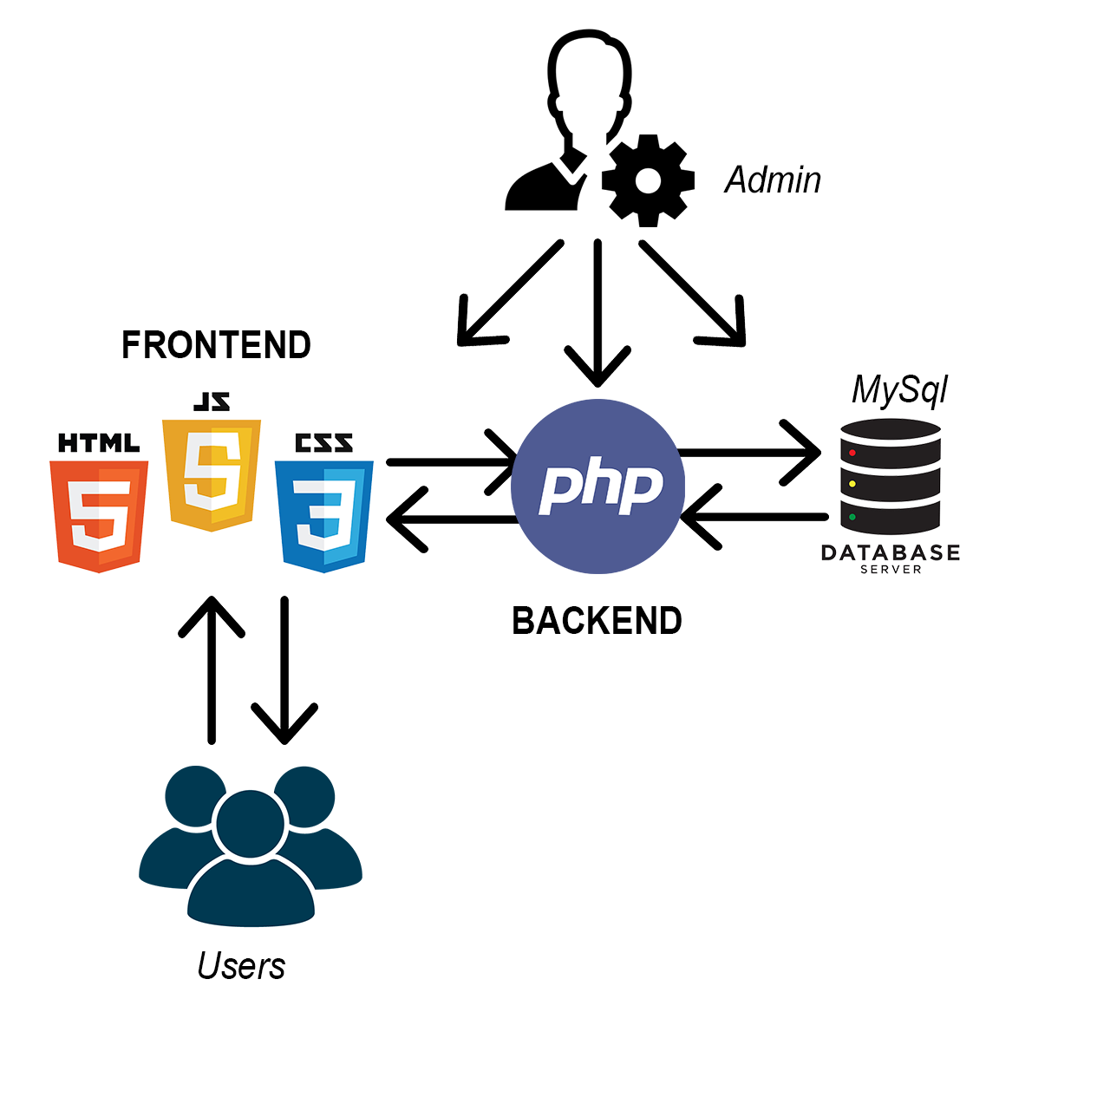
4. MODEL
Working of the Online Book Store

Slide 7
4. METHODOLOGY:
The above diagram gives an overview of the actual working of the online book store.
The admin has access to all three parts- the client side (Frontend), the server side (Backend) and the Database.
The users have access to view just the Frontend part of the website i.e, the User Interface of the website.
The frontend of the online book store is build using HTML, CSS and JavaScript languages, the backend is build using PHP and the Database consists of MySQL server.
The Database stores all the user data, the website data and also the data of the books available on the site.
The Database is linked to the Backend with php which on the other hand is connected to the Frontend.

Slide 8
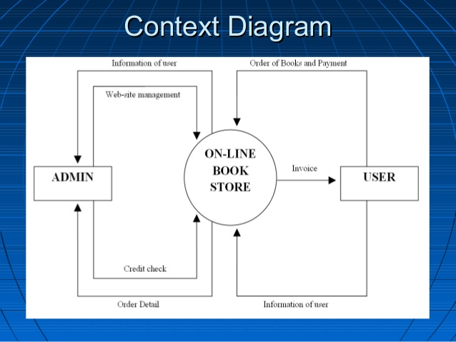
METHODOLOGY CONTD:
When the user searches for any book, frontend calls the data of the books through the backend which has a connected database and the details of the book are displayed on the screen of the user.
The same procedure is followed for payment details and also if the user wants to access his profile.

Slide 9
5. HARDWARE AND SOFTWARE REQUIREMENT:
Hardware Requirements:
User Requirements:
PC (Personal Computer) or workstation.
Processor- i5
Hard disk- 1 TB
Memory- 1 GB RAM
Server Requirements:
Apache2 web server.
Windows 7 and above
Web browsers like Mozilla Firefox, Google Chrome.

Slide 10
Software Requirements:
MySQL Database
Languages used-
Frontend- HTML, CSS and JavaScript
Backend- PHP
Database- MySQL

Slide 11
6. IMPLEMENTATION :
We started implementing our project by low fidelity and high fidelity wireframing the design of our project in Adobe XD.
We structured our website frontend using HTML and styled it using CSS -Bootstrap library and done Client side scripting using Javascript and JQUERY.
We have built our backend using PHP and MYSQL database.
We have then connected our frontend to the backend using the PHP language and then we create a Query using SQL language that links backend with our MYSQL database.
We have then hosted our website locally using the Apache and MYSQL modules of the Xampp web server software .
DEPARTMENT OF COMPUTER ENGINEERING

Slide 12
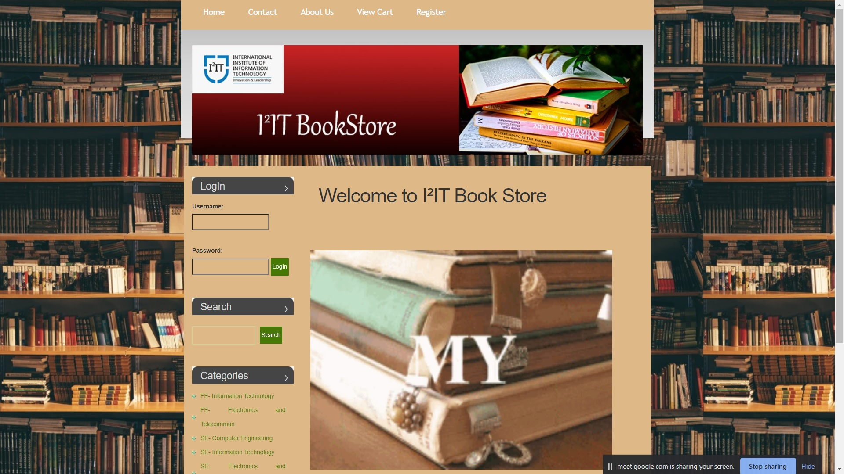
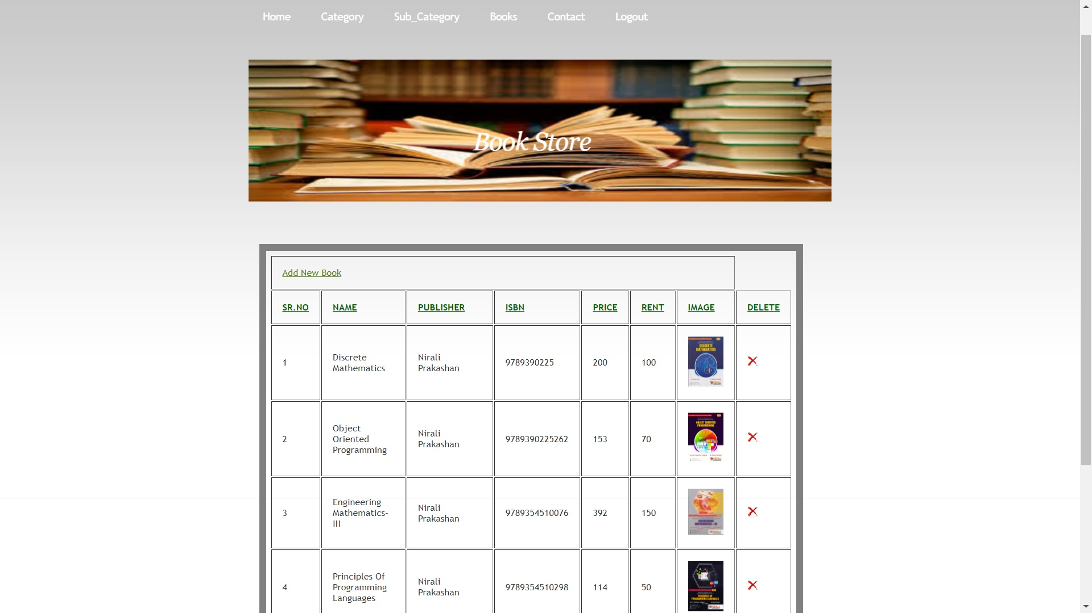
7. RESULTS :
DEPARTMENT OF COMPUTER ENGINEERING

Slide 13
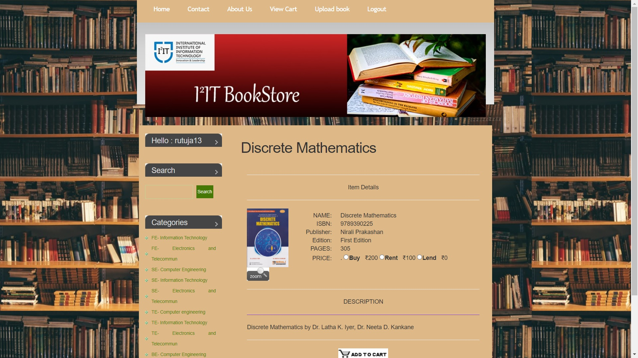
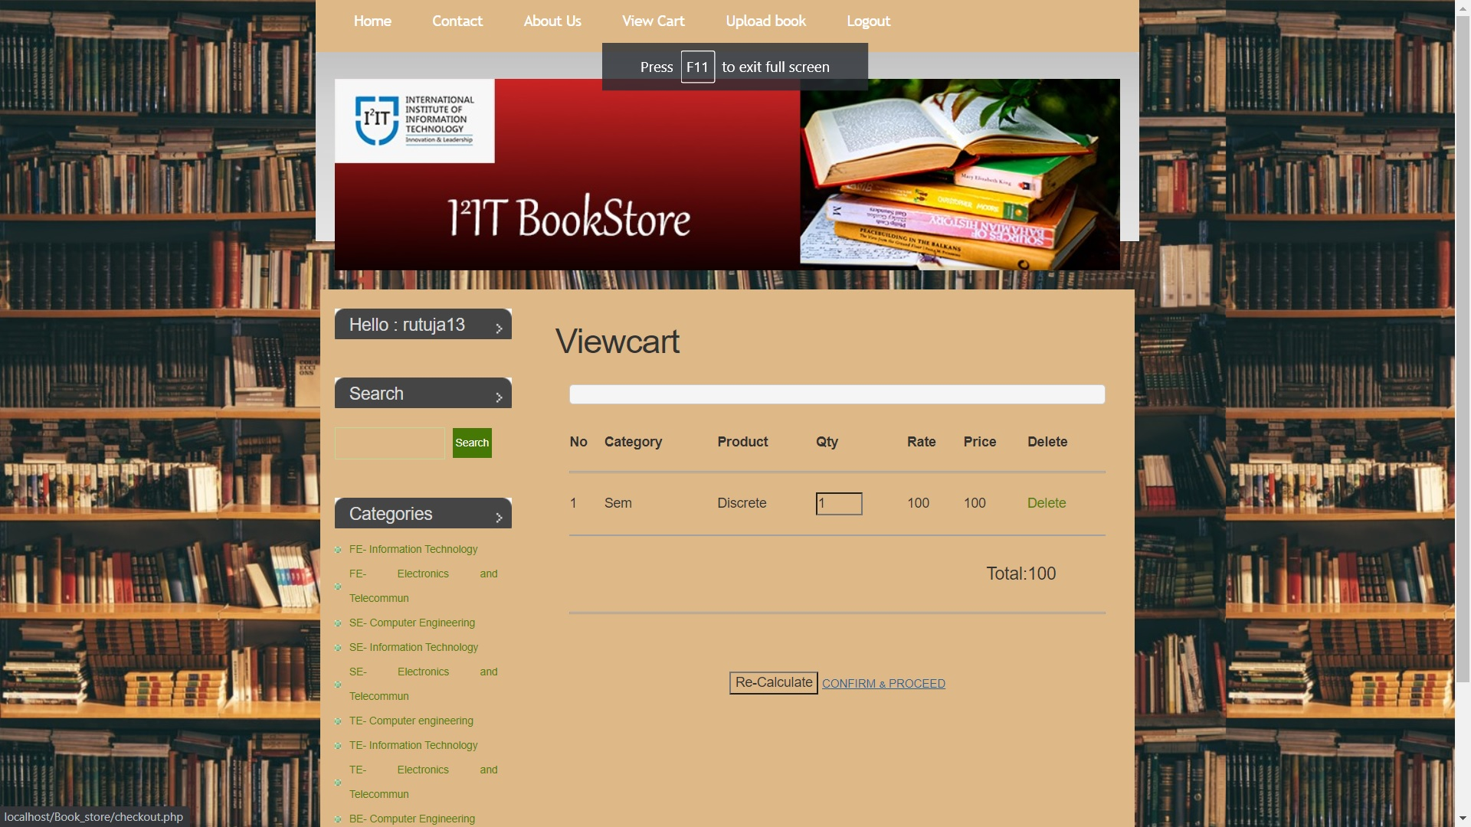
DEPARTMENT OF COMPUTER ENGINEERING

Slide 14
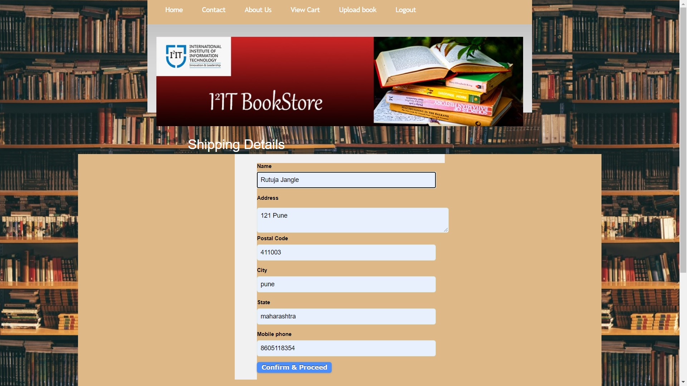
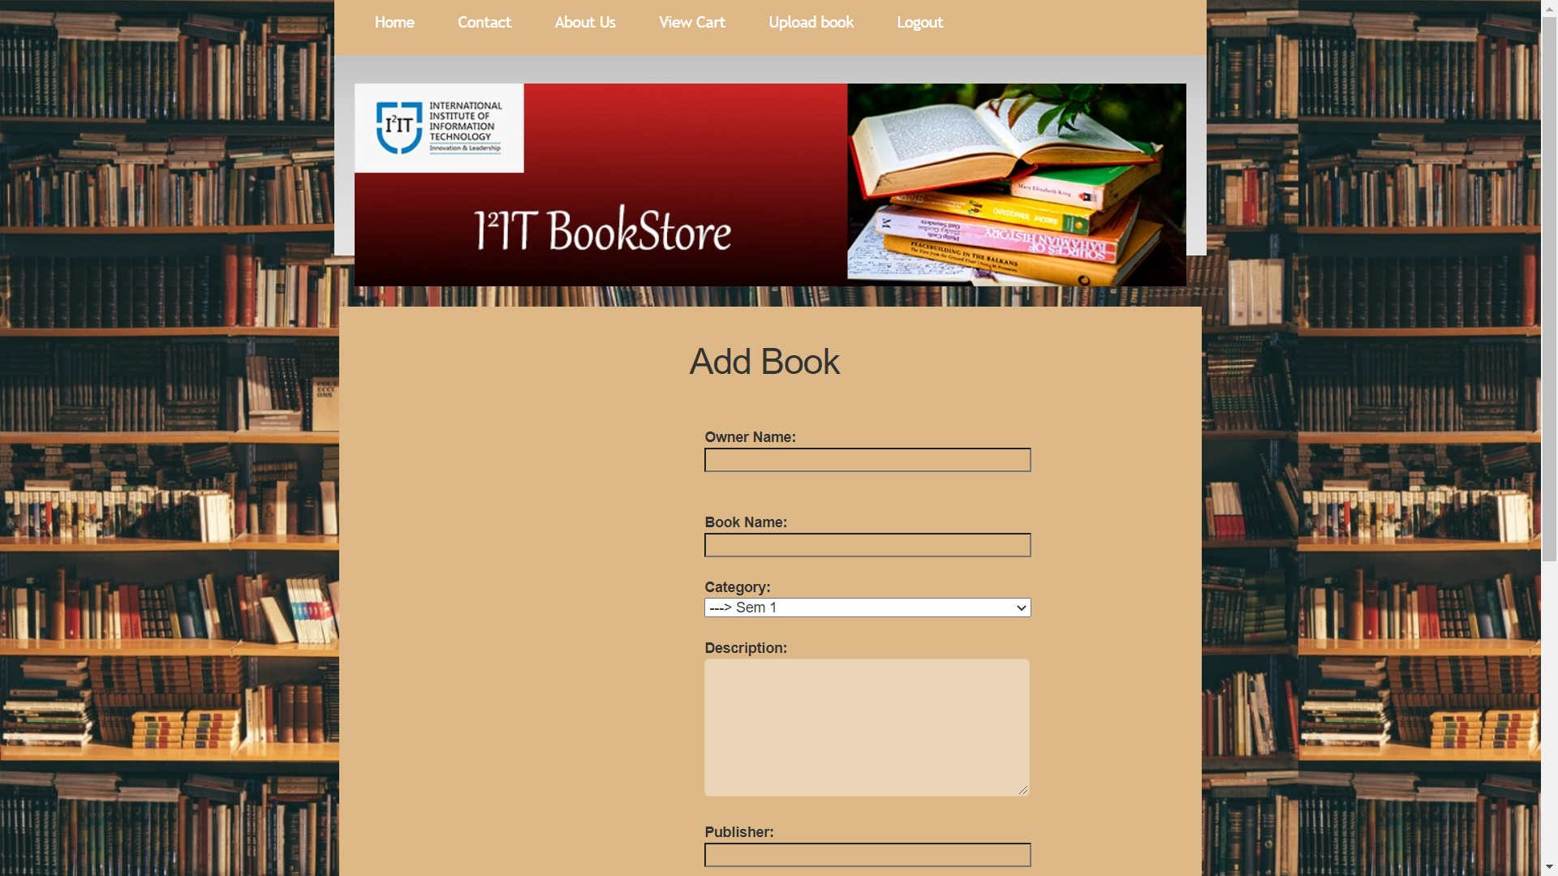
DEPARTMENT OF COMPUTER ENGINEERING

Slide 15
8. CHALLENGES FACED :
The first challenge we faced was for choosing the right technology stack for creating our website so that it will be user friendly.
Next we had to check for online identity verification for each prospective user in order to avoid fraudulent activities through the website.
Making the site responsive was one of the major challenges that we faced while implementing our project.
Integrating a solution for the payment gateway at the checkout was another challenge that we faced.
DEPARTMENT OF COMPUTER ENGINEERING

Slide 16

9. CONCLUSION AND FUTURE SCOPE :
In conclusion ,we can say that this bookstore system will help the students to easily get the books online without going to the bookstore themselves by spending very less amount or even for free.
This system is solution oriented as it reduces human efforts and saves time.
Also reusability of books to save nature is what we have achieved through this project.
DEPARTMENT OF COMPUTER ENGINEERING

Slide 17

9. FUTURE SCOPE :
Website can be hosted on online servers to make it accessible worldwide.
More advance software with other facilities can be given which will increase the applicability and usage of this project.
An SMS based notification system can be introduced which will notify the user about books that are back in stock and also about payment and shipping details.
An application can also be developed based on this website.
DEPARTMENT OF COMPUTER ENGINEERING

Slide 18
THANK YOU!!!

